Slide 1
Data Analyst Portfolio
Suhasini Cheryala

Slide 2
About Me
Your Name
I am Suhasini Cheryala, working as a Customer Service Representative in the mobile industry from 1 year and 7 months.
From March 2017 to July 2022, I took a break to fulfill family responsibilities and utilized this time to enhance my skills. During this period, I underwent training in TestNG, Cucumber, and JavaScript, ultimately earning ISTQB Foundation Level certification.
With a background in software, I bring 2.6 years of expertise encompassing both manual testing and automation. I have adeptly worked with various technologies, including Core Java, Selenium, Jira, Bugzilla, SQL, Oracle and Excel.
My experience as a customer service representative has taught me the importance of data in shaping the customer experience. The dashboard I use isn't just a tool; it's like a window showing me every detail of a customer's journey from the beginning of a call to its successful resolution. It tracks my performance throughout the day on all calls and provides insights for each interaction. Thus, I've realized that data is crucial for improving my strategies to provide the best customer service. This deep understanding has sparked my curiosity and ambition to explore the world of data analytics.

Slide 3
How does data add value to organisations?
Data:
Data is a raw fact that can be in the form of numbers(sum, count, calculate, floats, fractions), observations, texts( measurements, seasons, analysis, frequency).
Why is data important to organizations?
Problem Identification:
Data serves as a powerful tool for pinpointing the root cause of issues through surveys and feedback, Analyzing data enables a more informed and systematic approach to understanding and resolving challenges.
Informed Decision-Making:
Effective use of data provides valuable insights into problems, eliminating guesswork. By analyzing trends, behaviors, and patterns, informed decisions can be made. This analysis not only allows for the introduction of new products or innovations but also enables the enhancement of existing products, ultimately improving quality, enhancing user experiences, and simplifying people's lives.
Increase in Revenue:
Strategic improvements in services, such as the introduction of new seasonal offers and enhanced offerings, effective impact on boosting sales for organizations. This, in turn, contributes to a substantial increase in the company's overall revenue. ,desired situation and gap between them.

Slide 4
Sub National Electricity Consumption
Suhasini Cheryala
Electricity consumption data analysis.
My Objective is to find the Sub National Electrical Consumption with a focus on
To find the total electricity consumption with standard meters and E7 meters region wise.
To find Electrical consumption from 2011 to 2021.
To compare the Domestic and Non Domestic Electrical Consumption.
To find the Electrical and Gas in Domestic and Domestic
To achieve the above, I have collected the raw data in the form of CSV file from open source https://data.gov.uk/ and cleaned the data through Power query. The data is available from 2005 to 2021.
At present I have concentrated on only 2021 electrical consumption and comparison between Domestic and Non Domestic using standard meters and E7 meters.
Removed the duplicates using filters and created Pivot tables and charts based on them.

Slide 5
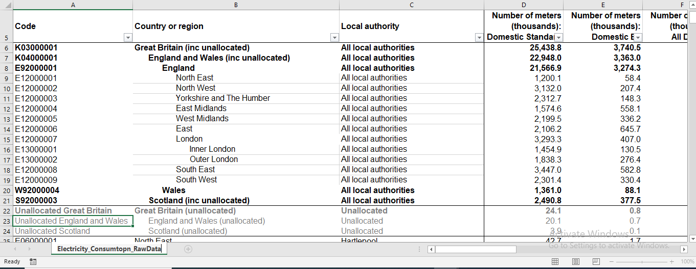
Sub National Electricity Consumption
Suhasini Cheryala
Data Sourcing, Integration, Validation, Cleaning & Formatting Data in Excel
I have collected the raw data in the form of .CSV file

Slide 6
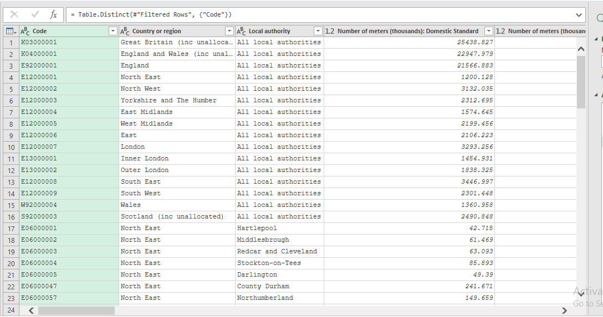
Sub National Electricity Consumption
Suhasini Cheryala
Data Sourcing, Integration, Validation, Cleaning & Formatting Data in Excel
Used Power query to clean the data by removing duplicates, spaces and changing the data types for the columns..

Slide 7
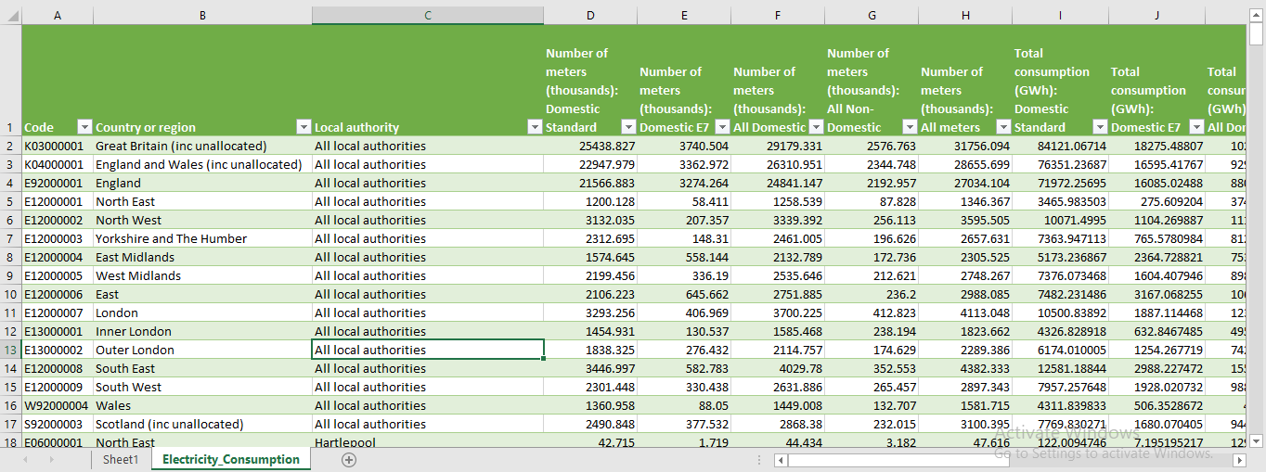
Sub National Electricity Consumption
Suhasini Cheryala
Data Sourcing, Integration, Validation, Cleaning & Formatting Data in Excel
The final output after cleaning the data.

Slide 8
Sub National Electricity Consumption
Suhasini Cheryala
Created Pivot tables for Electricity Consumption with standard meters and E7 meters.
Electricity Consumption with Standard meters
Country or region | Number of Standard meters | Total consumption with standard meters
East | 4212 | 14964
East Midlands | 3149 | 10346
Inner London | 2910 | 8654
North East | 2400 | 6932
North West | 6264 | 20143
Outer London | 3677 | 12348
Scotland | 2487 | 7759
South East | 6894 | 25162
South West | 4603 | 15915
Wales | 2722 | 8624
West Midlands | 4399 | 14752
Yorkshire and The Humber | 4625 | 14728
Grand Total | 48343 | 160327
Electricity Consumption with E7 meters
Row Labels | Total Number of E7 meters | Total consumption with E7 meters
East | 1291 | 6,334
East Midlands | 1116 | 4,729
Inner London | 261 | 1,266
North East | 117 | 551
North West | 415 | 2,209
Outer London | 553 | 2,509
Scotland | 377 | 1,680
South East | 1166 | 5,976
South West | 661 | 3,856
Wales | 176 | 1,013
West Midlands | 672 | 3,209
Yorkshire and The Humber | 297 | 1,531
Grand Total | 7102 | 34,862

Slide 9
Sub National Electricity Consumption
Suhasini Cheryala
Difference of Electricity Consumption with standard meters and E7 meters.

Slide 10
Sub National Electricity Consumption
Suhasini Cheryala
Pivot tables for Region Wise Domestic and Non-Domestic Electricity Consumption
Total Electricity Consumption: Domestic
Row Labels | Total Number of meters | Total Electricity consumption
East | 5504 | 21299
East Midlands | 4266 | 15076
Inner London | 3171 | 9919
North East | 2517 | 7483
North West | 6679 | 22352
Outer London | 4230 | 14857
Scotland | 2864 | 9438
South East | 8060 | 31139
South West | 5264 | 19771
Wales | 2898 | 9636
West Midlands | 5071 | 17961
Yorkshire and The Humber | 4922 | 16259
Grand Total | 55445 | 195189
Total Electricity Consumption: Non- Domestic
Row Labels | Total Number of meters | Total Electricity consumption
East | 472 | 28627
East Midlands | 345 | 24332
Inner London | 476 | 26672
North East | 176 | 13512
North West | 512 | 35089
Outer London | 349 | 17895
Scotland | 230 | 13132
South East | 705 | 40586
South West | 531 | 24617
Wales | 265 | 18491
West Midlands | 425 | 26669
Yorkshire and The Humber | 393 | 28217
Grand Total | 4881 | 297838

Slide 11
Suhasini Cheryala
Sub National Electricity Consumption
Region wise comparison between Domestic and Non Domestic electricity consumption

Slide 12
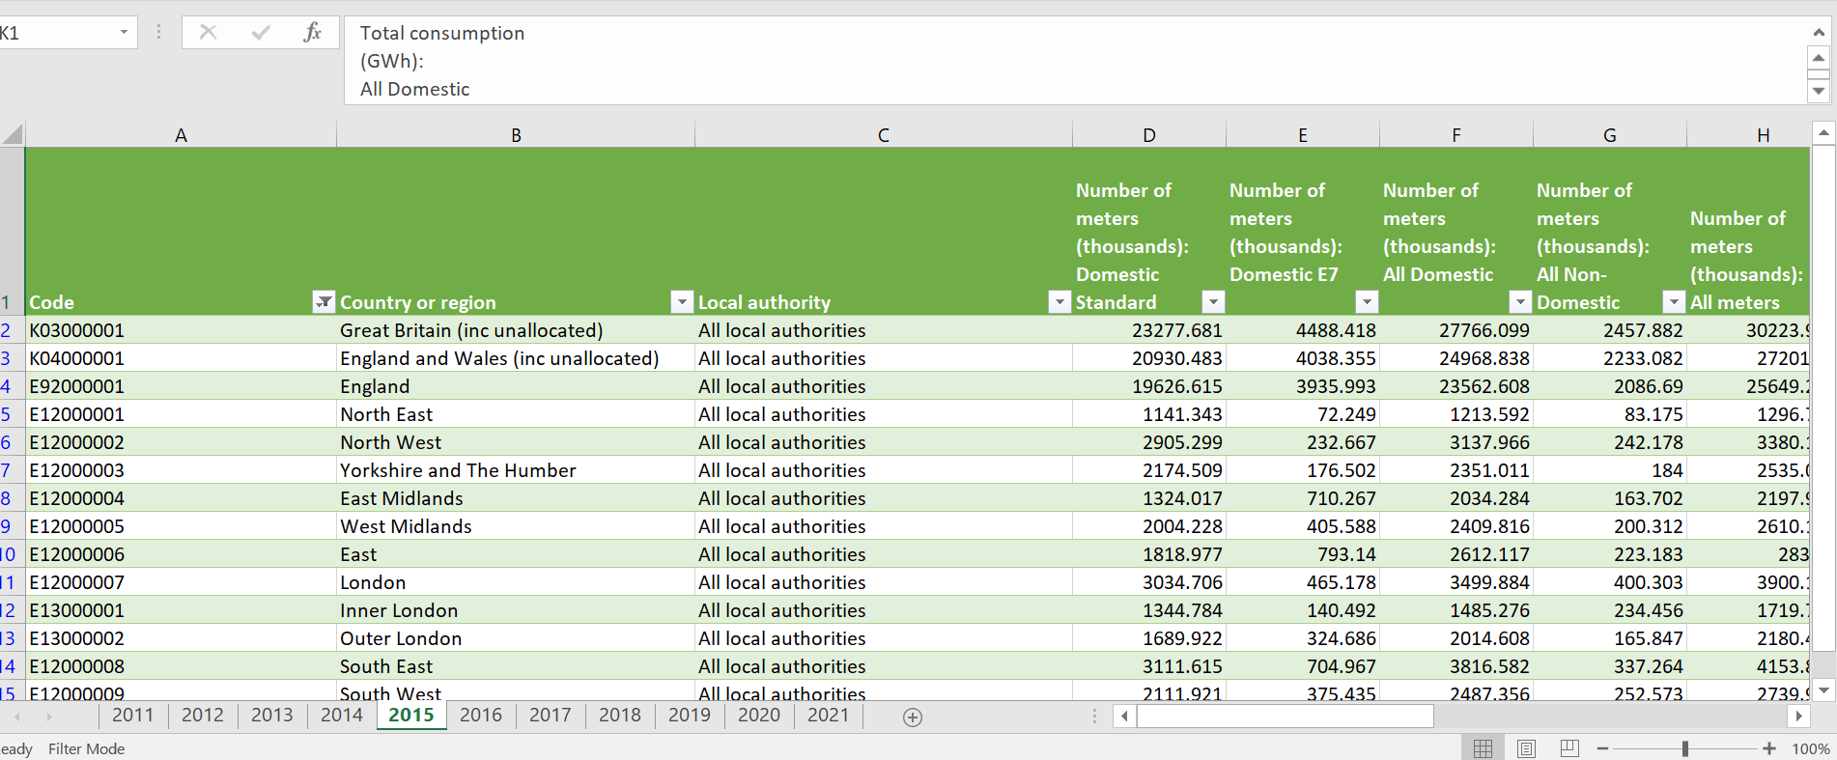
Sub National Electricity Consumption from 2011 to 2021
Suhasini Cheryala
I wanted to explore the domestic electricity consumption from 2011 to 2021 in all regions.
Due to all local authorities present under each region, many duplicates for each region are created .Due to this a simple and clear graph is not coming up. To avoid this, I have removed the duplicates in the region column.
For this , I have created a separate sheet and created a region column with unique values and used it in VLookup formula to bring values from different worksheets (from 2011 to 2021) and created a Pivot table. Created a visualisation which gives information about percentage change from 2011 to 2021.

Slide 13
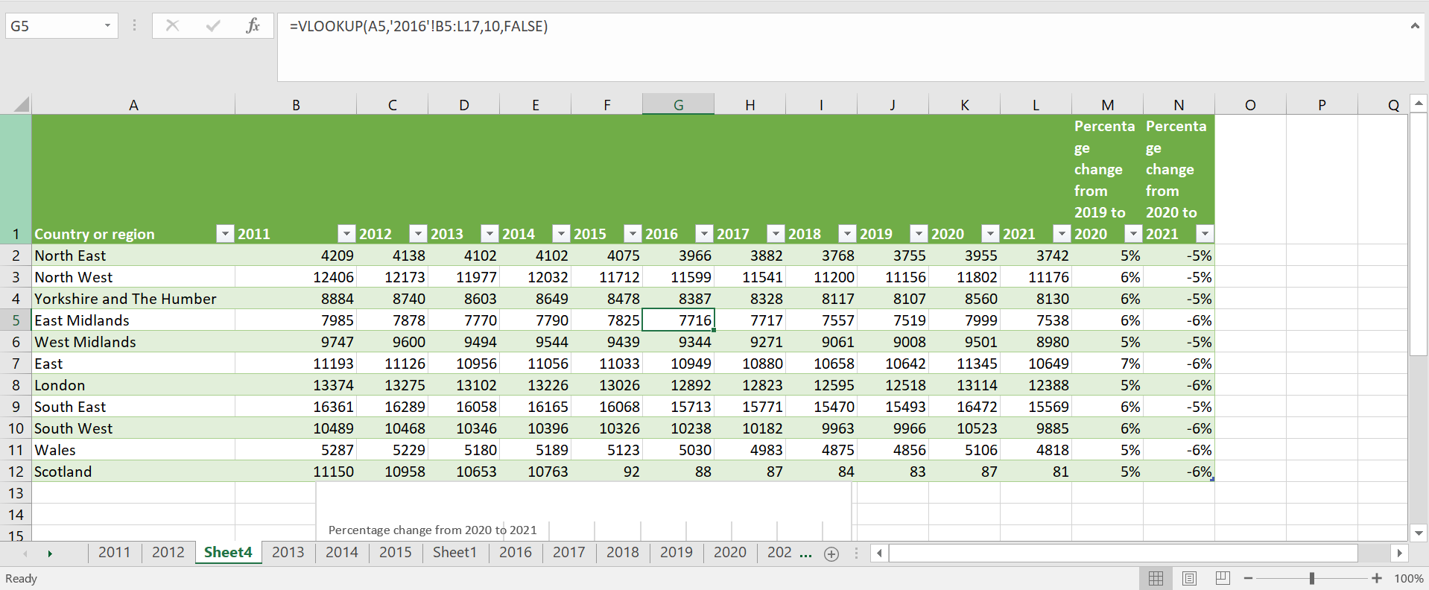
Observation and interpretation
Suhasini Cheryala
I calculated the percentage difference from 2019 to 2020 and it can be seen East marks the highest electricity consumption compared to other regions. As it was Lockdown during 2020 the consumption across all regions increased.
Also I have calculated the percentage difference from 2020 to 2021.It can be seen that electricity consumption decreased and back to same as 2019 approximately.as Lockdown was lifted.
After careful observation of all data sets , I observed that Domestic Electricity consumption from 2011 to 2021 is decreased comparatively.

Slide 14
Sub National Electricity and Gas Consumption
Suhasini Cheryala

Slide 15
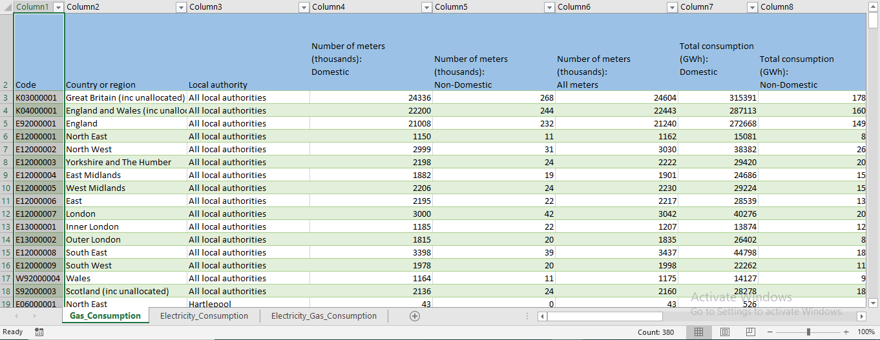
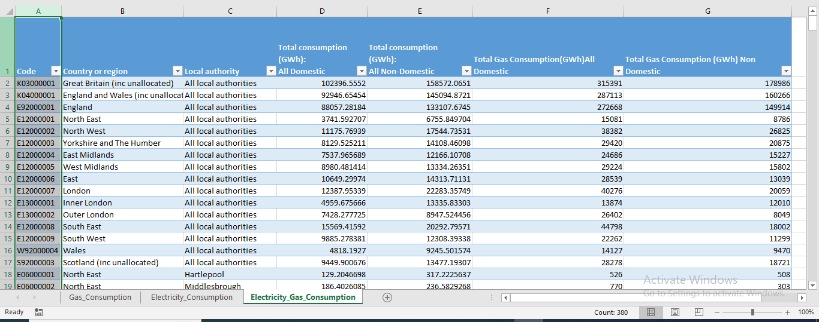
Sub National Electricity and Gas Consumption
Suhasini Cheryala
My objective is to assess the regional consumption of Electricity and Gas in both Domestic and Non-Domestic sectors.
To achieve this, I acquired Gas Consumption data from [https://data.gov.uk/], originally in CSV format, and transformed it into an xlsx file using Power Query.
Utilizing the VLOOKUP formula, I integrated the Gas Consumption dataset with the Electricity Consumption dataset, linking them through a common primary key (Code). This enabled me to examine the total Electricity and Gas consumption categorized by regions

Slide 16
Sub National Electricity and Gas Consumption
Suhasini Cheryala
My Objective is to find the total consumption of Electricity and Gas under each region.
Domestic Electricity and Gas Consumption
Non-Domestic Electricity and Gas Consumption
Country/Region | Total Gas Consumption | Total Electric consumption
East | 57078 | 21299
East Midlands | 49373 | 15076
Inner London | 27747 | 9919
London | 40276 | 12388
North East | 30162 | 7483
North West | 76764 | 22352
Outer London | 52804 | 14857
Scotland | 28235 | 9438
South East | 89595 | 31139
South West | 44524 | 19771
Wales | 28253 | 9636
West Midlands | 58448 | 17961
Yorkshire and The Humber | 58840 | 16259
Grand Total | 642100 | 207577
Country/Region | Total Electric consumption | Total Gas Consumption
East | 28627 | 26079
East Midlands | 24332 | 30454
Inner London | 26672 | 24020
London | 22283 | 20059
North East | 13512 | 17573
North West | 35089 | 53651
Outer London | 17895 | 16098
Scotland | 13132 | 18678
South East | 40586 | 36004
South West | 24617 | 22597
Wales | 18491 | 18941
West Midlands | 26669 | 31603
Yorkshire and The Humber | 28217 | 41750
Grand Total | 320122 | 357507

Slide 17
Sub National Electricity and Gas Consumption
Suhasini Cheryala
My Objective is to find the total consumption of Electricity and Gas under each region.

Slide 18
Observation and interpretation
Suhasini Cheryala
Electricity Consumption Trends:
Standard meter electricity consumption is higher in England compared to other regions, with the North East exhibiting the least consumption.
Economic 7 meter electricity consumption during off-peak hours is also higher in England, with the North East again marking the least consumption.
Domestic electricity consumption from 2011 to 2021 has decreased overall.
There was an increase in electricity consumption in 2020 compared to 2019, likely due to the lockdown causing more people to work from home. However, consumption decreased when comparing 2020 to 2021 after the lockdown was lifted.
Regional Variances:
The South East region marks the highest domestic and non-domestic electric consumption.
Scotland exhibits lower non-domestic consumption, while the North East shows lower domestic consumption.
Scotland also marks the highest decrease in electricity consumption, whereas there is no change observed in the North East region.

Slide 19
Observation and interpretation
Suhasini Cheryala
Impact of E7 Meters:
The decrease in electricity consumption from 2020 to 2021 could be attributed to the usage of E7 meters, which might have contributed to more efficient electricity usage during peak and off-peak hours.
Regional Electricity and Gas Consumption:
The South East region shows higher consumption compared to Wales in both electricity and gas consumption.
In terms of non-domestic consumption, the North West marks the highest, while the North East marks the lowest.

Slide 20
Observation and interpretation
Suhasini Cheryala
In conclusion, the analysis suggests that there are notable differences in electricity consumption patterns across regions, with factors such as meter types and lockdown measures playing significant roles. Additionally, understanding these regional variances is crucial for developing targeted strategies to manage and optimize electricity usage efficiently.

